Slide 1
DataForGood
https://drive.google.com/file/d/1y-27nbCbAPeFGbw5v-7lfuDNJhdrfrdy/view
https://docs.google.com/presentation/d/115W2s73LTXi4K7DCGNgFKD_n6oelntUKivhqniZvXyo/edit#slide=id.g40b83989cd_0_68
http://dataforgood.no/

Slide 2
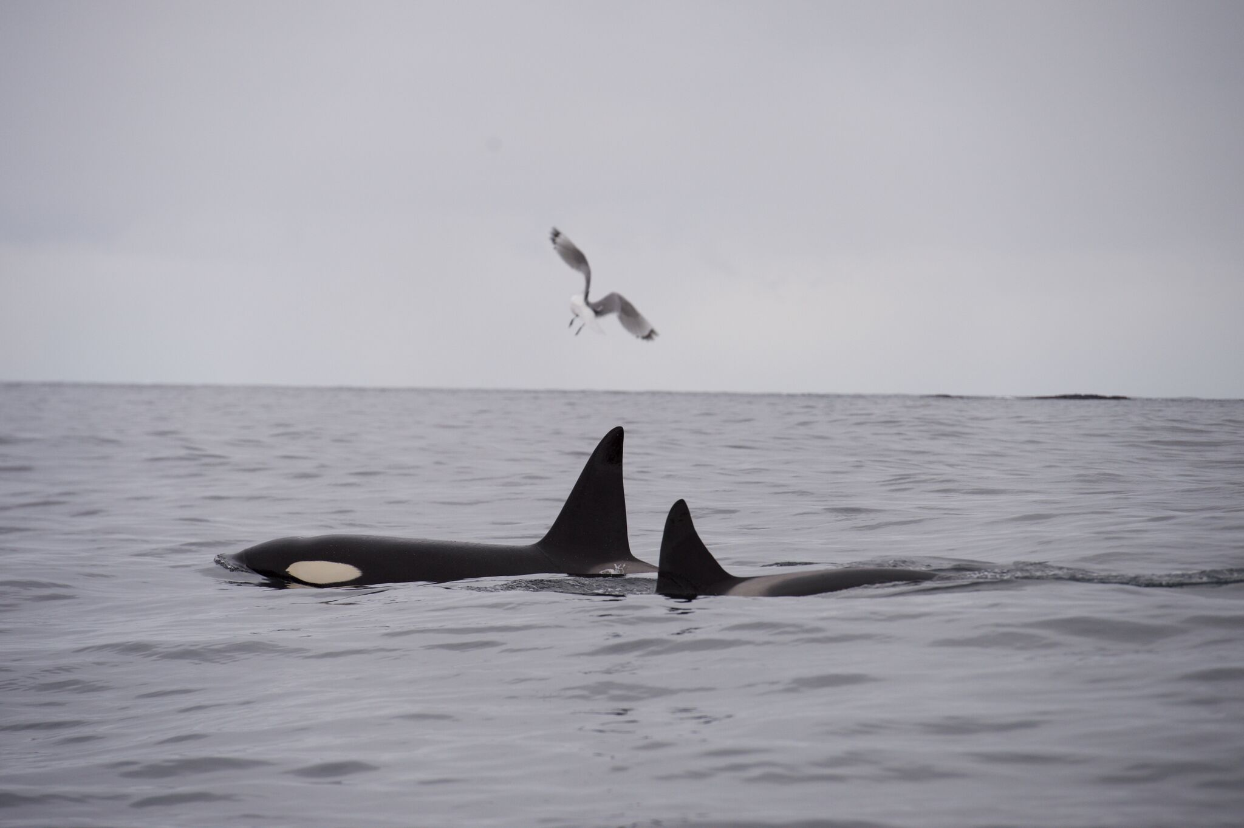

OrcaTag – a Data For Good project
https://github.com/bjornhjelle/orcatag
© Norwegian Orca Survey

Slide 3
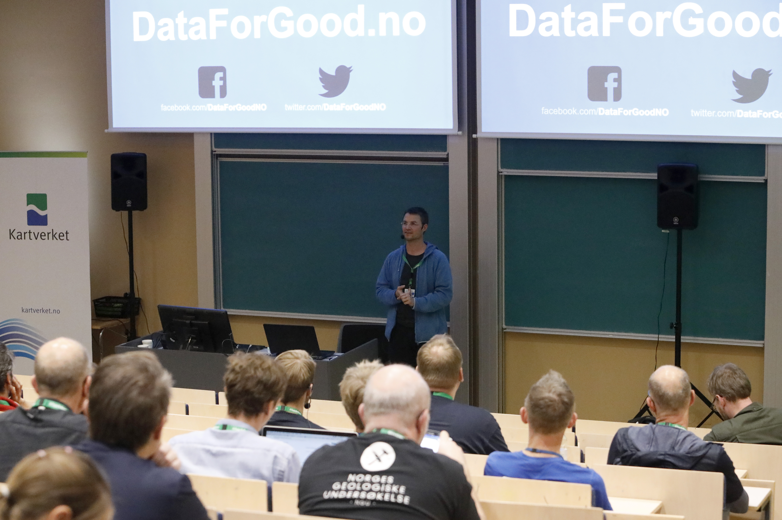

Slide 4
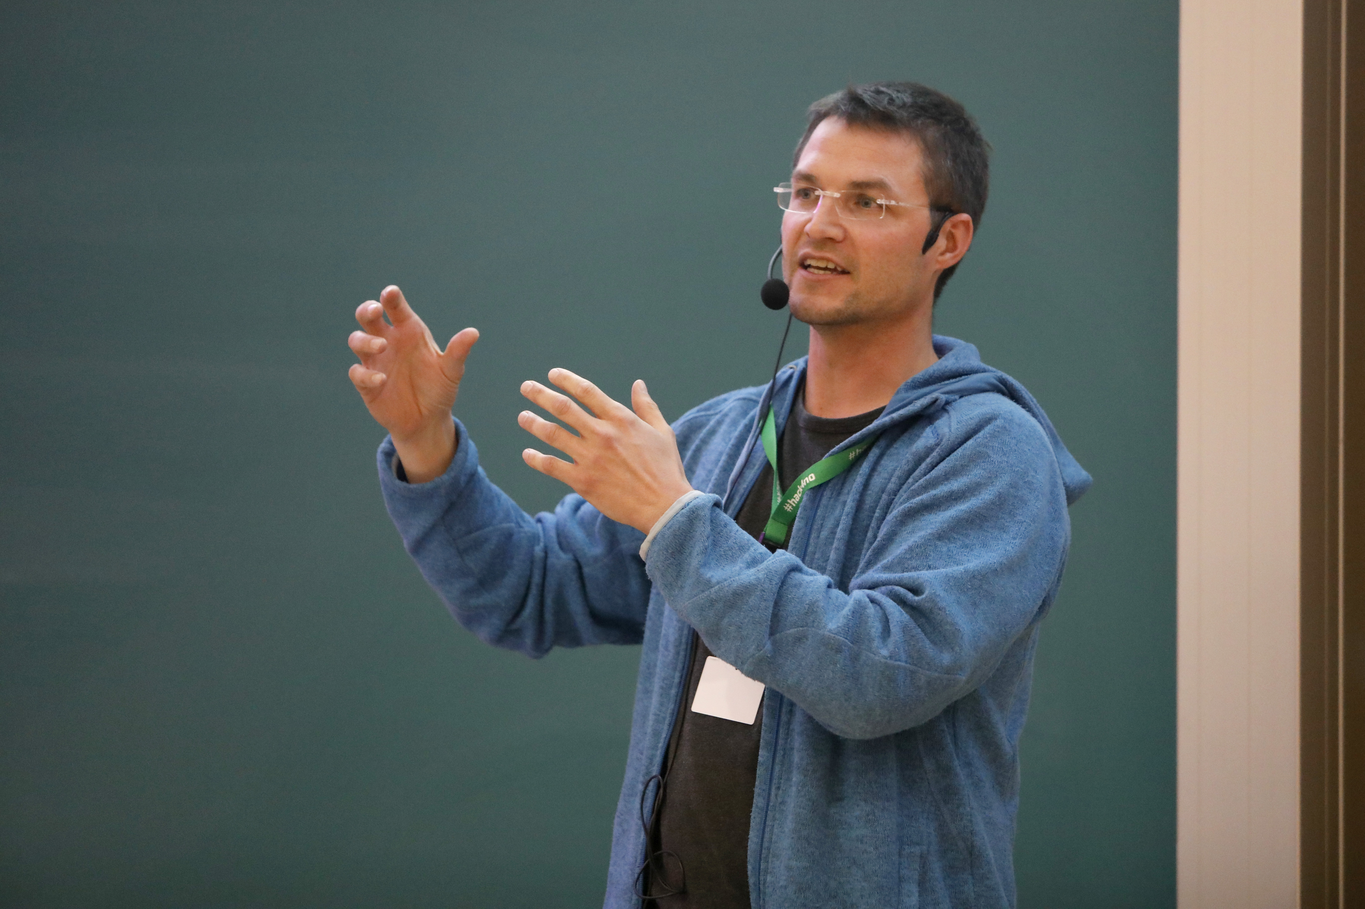

Slide 5
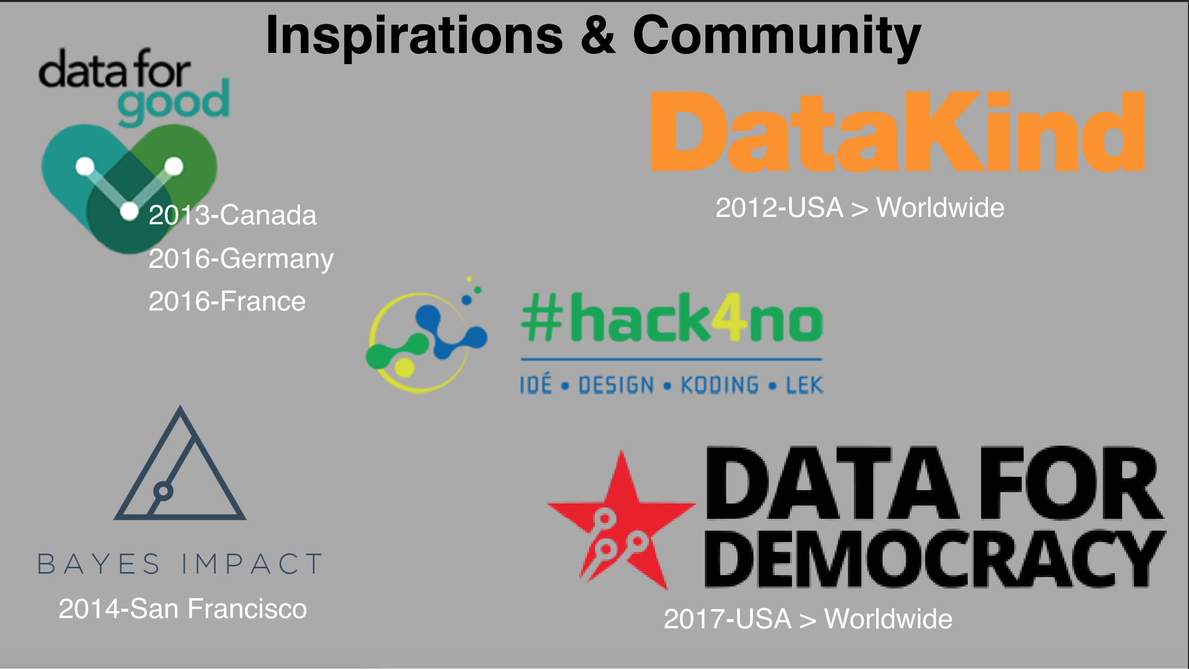

Slide 6
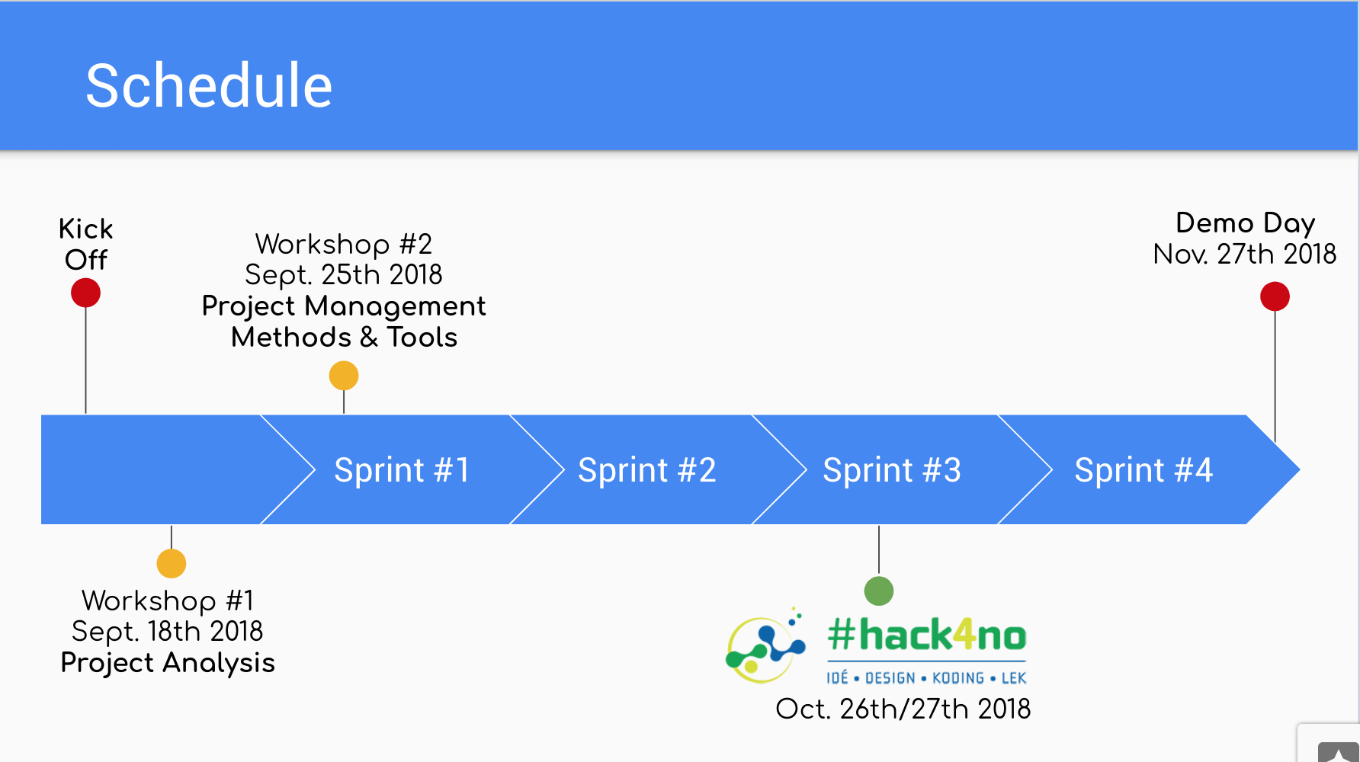

Slide 7
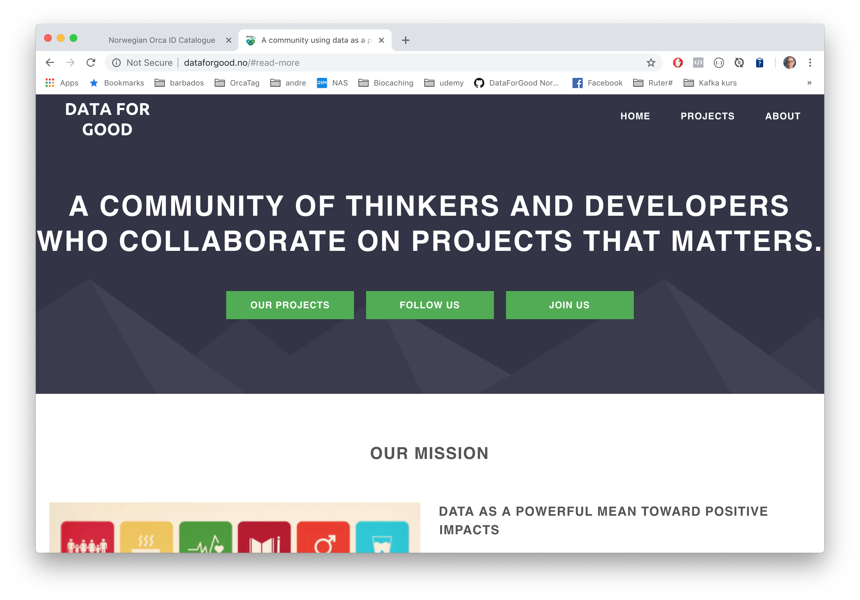

Slide 8
OrcaTag – a Data For Good project
https://github.com/bjornhjelle/orcatag
© Norwegian Orca Survey

Slide 9
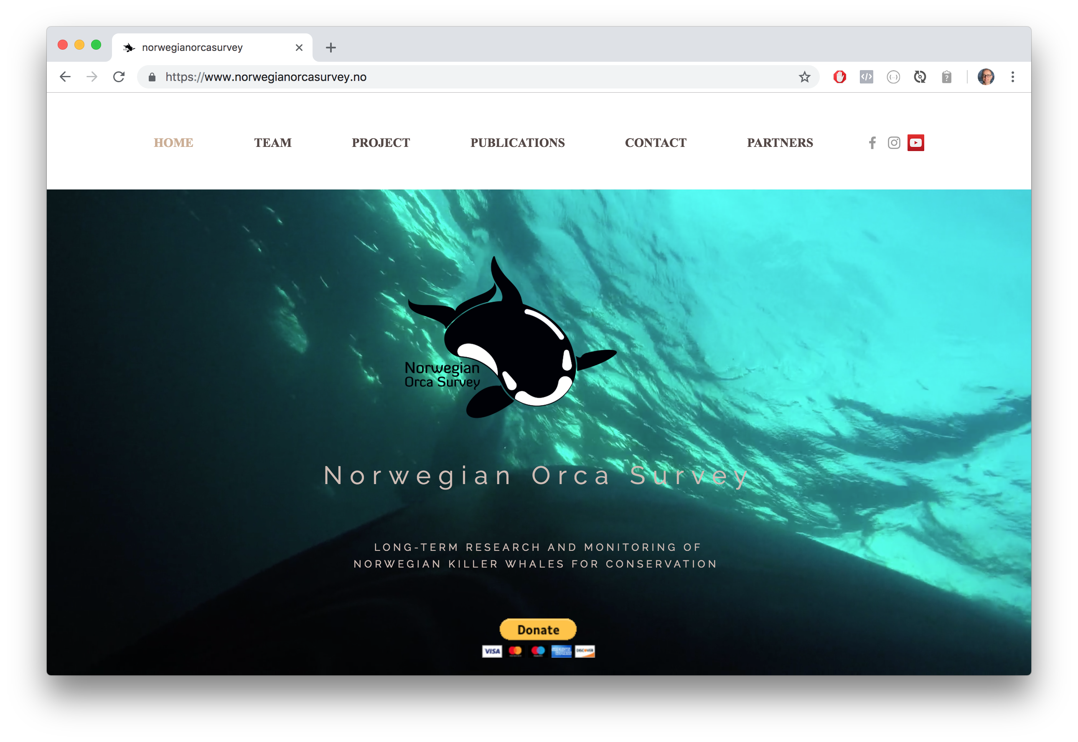
Norwegian Orca Survey

Slide 10
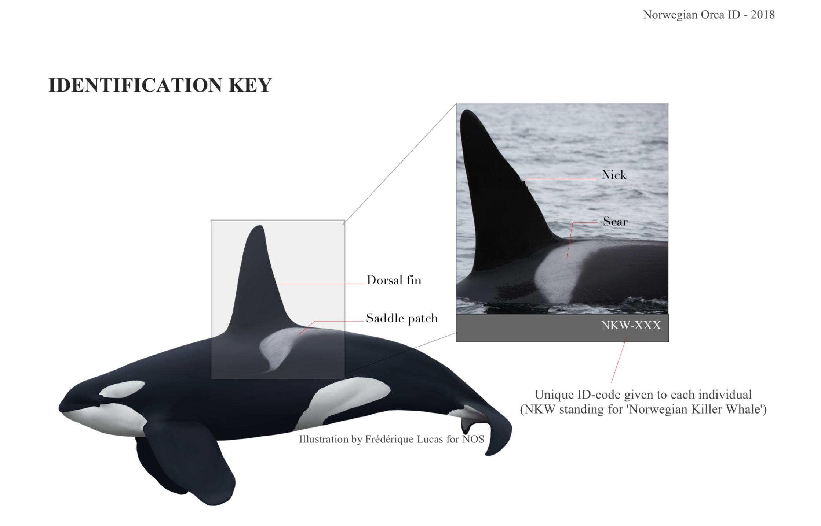

Slide 11
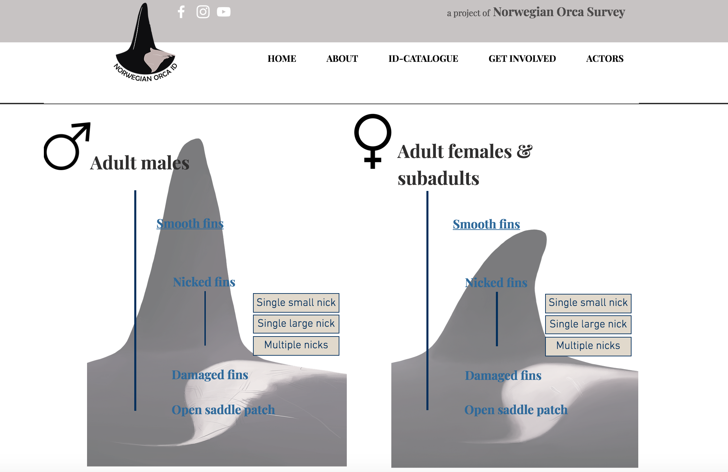
Tags

Slide 12
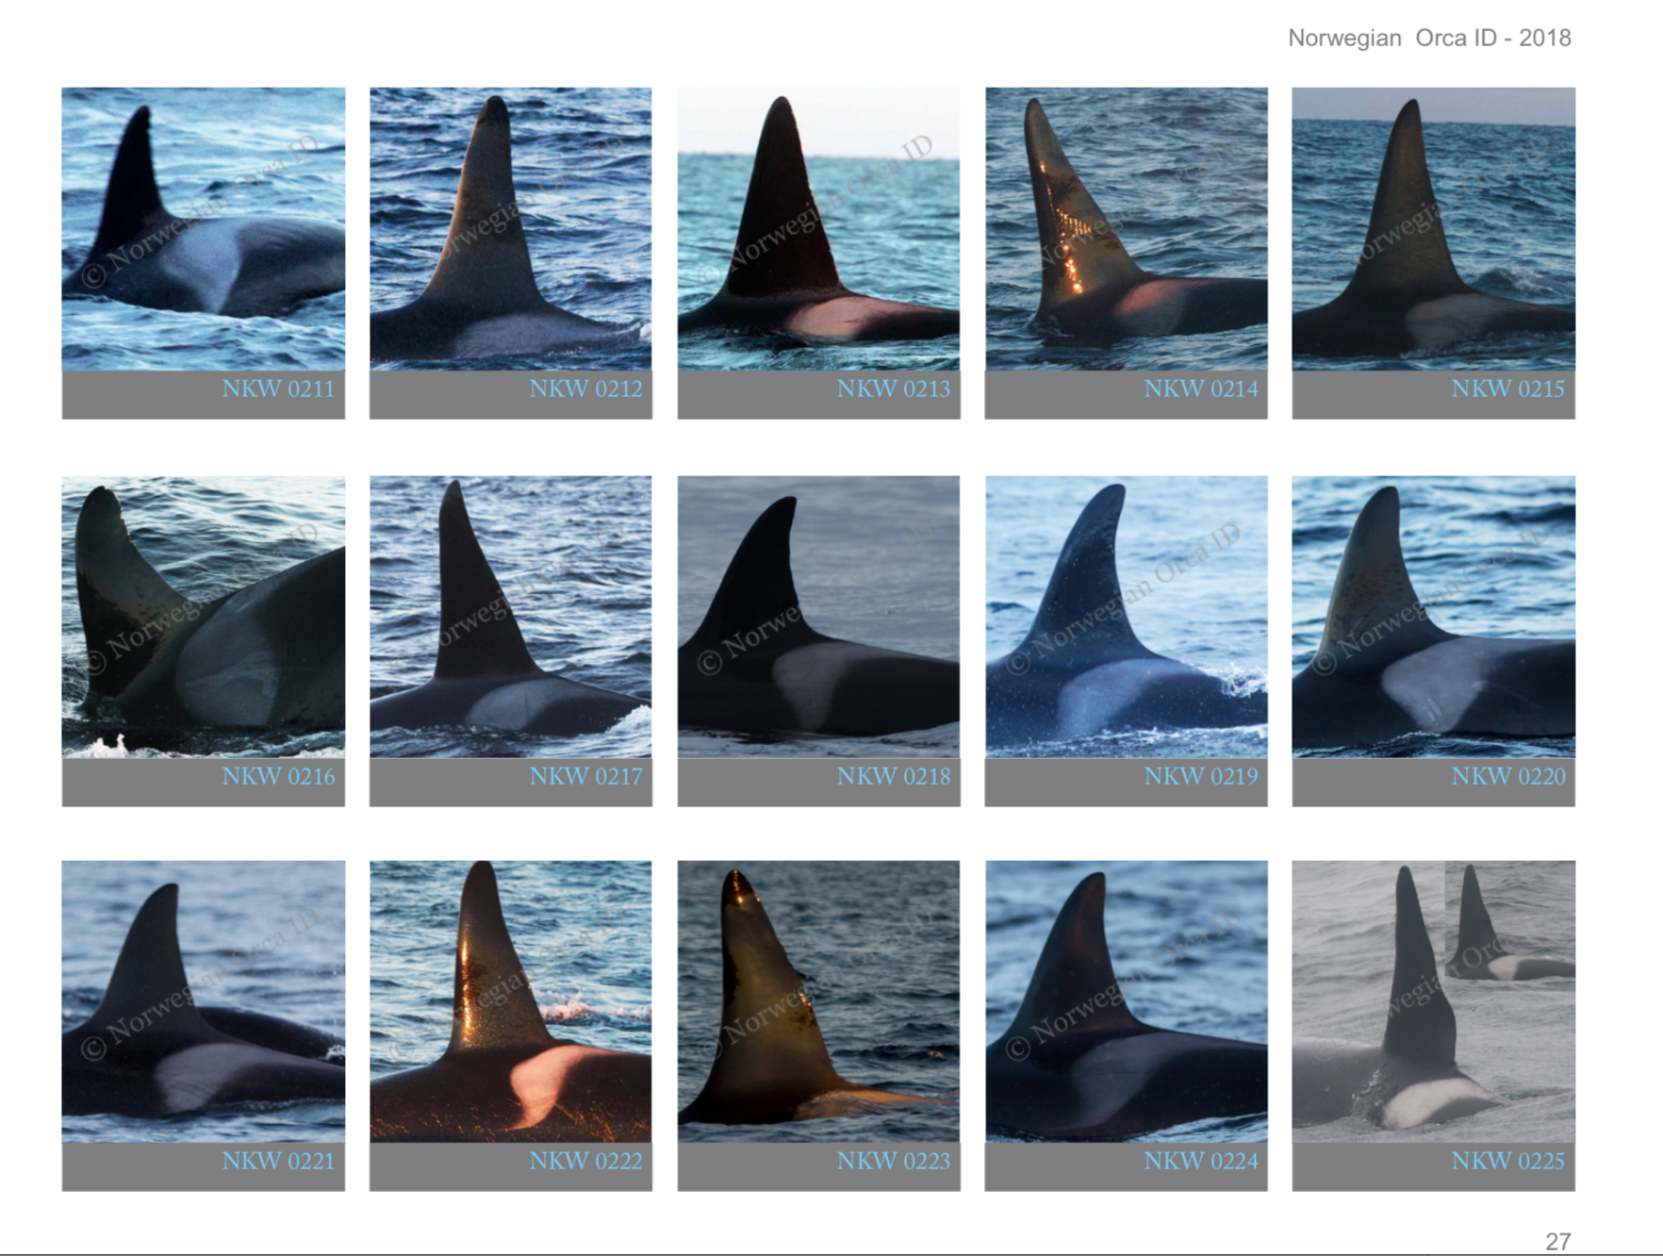
Norwegian Orca ID Catalogue – 1056 identified orcas

Slide 13
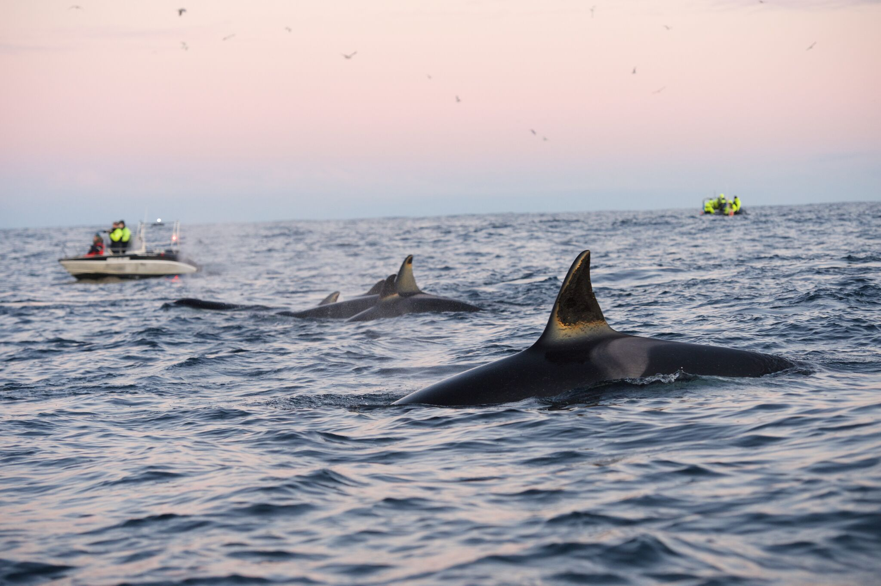
Collection of 200 000 pictures (sightings)
© Norwegian Orca Survey

Slide 14
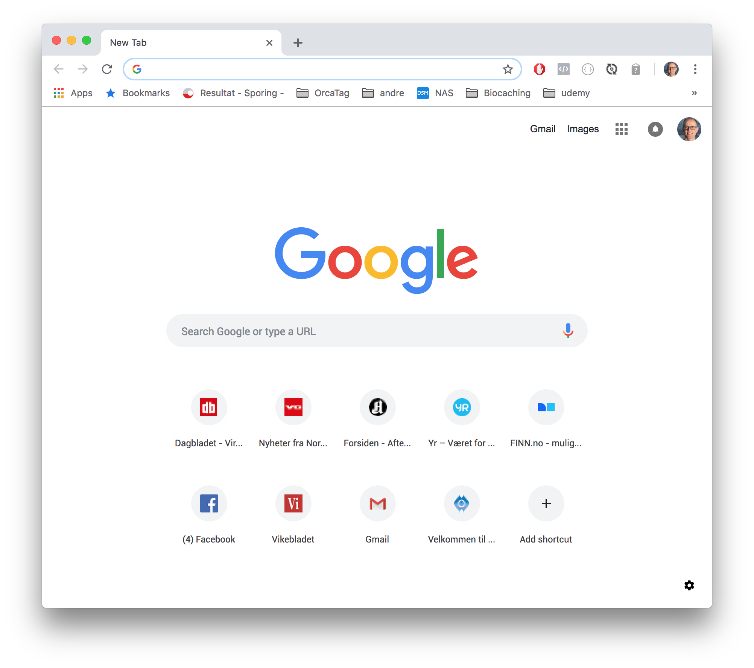
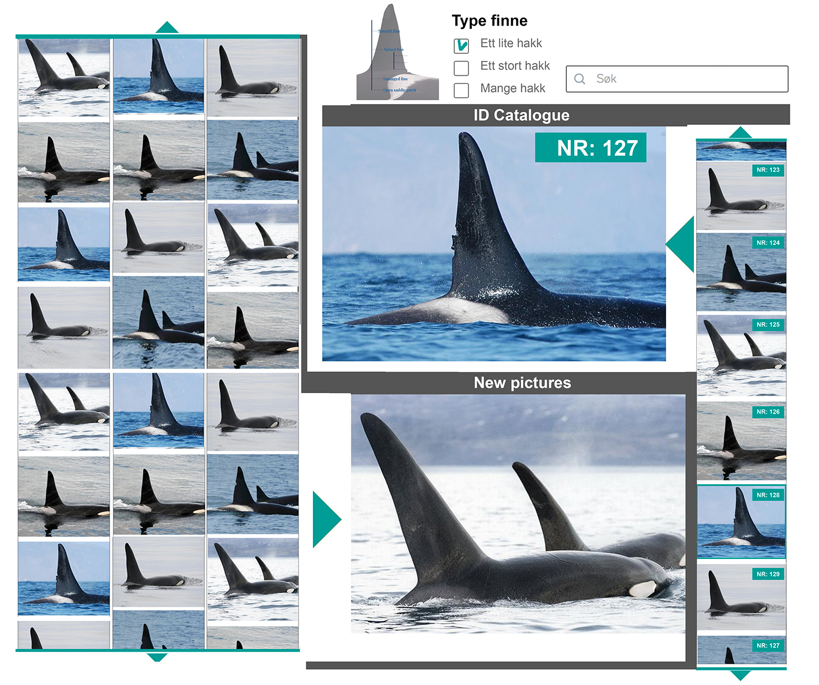
OrcaTag will help make sense of the pictures

Slide 15

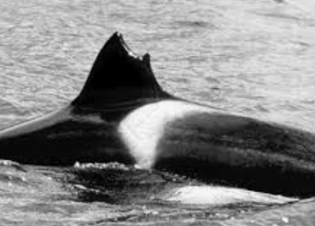
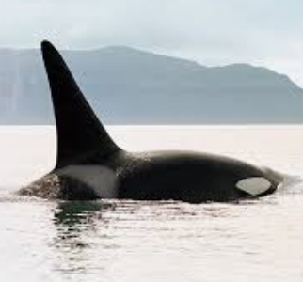

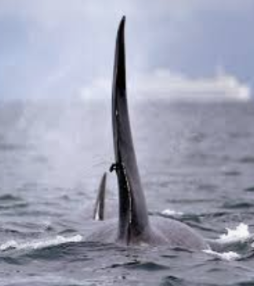
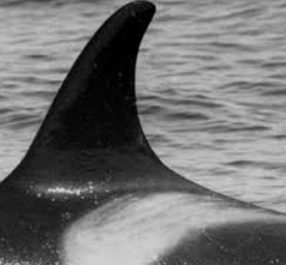
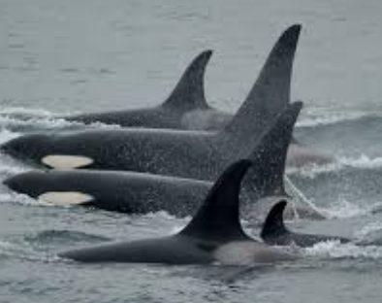
Technical architecture
Machine learning pipeline
localisation
normalisation
classification
REST-services
Upload
pictures
File storage
Metadata
Database

Slide 16
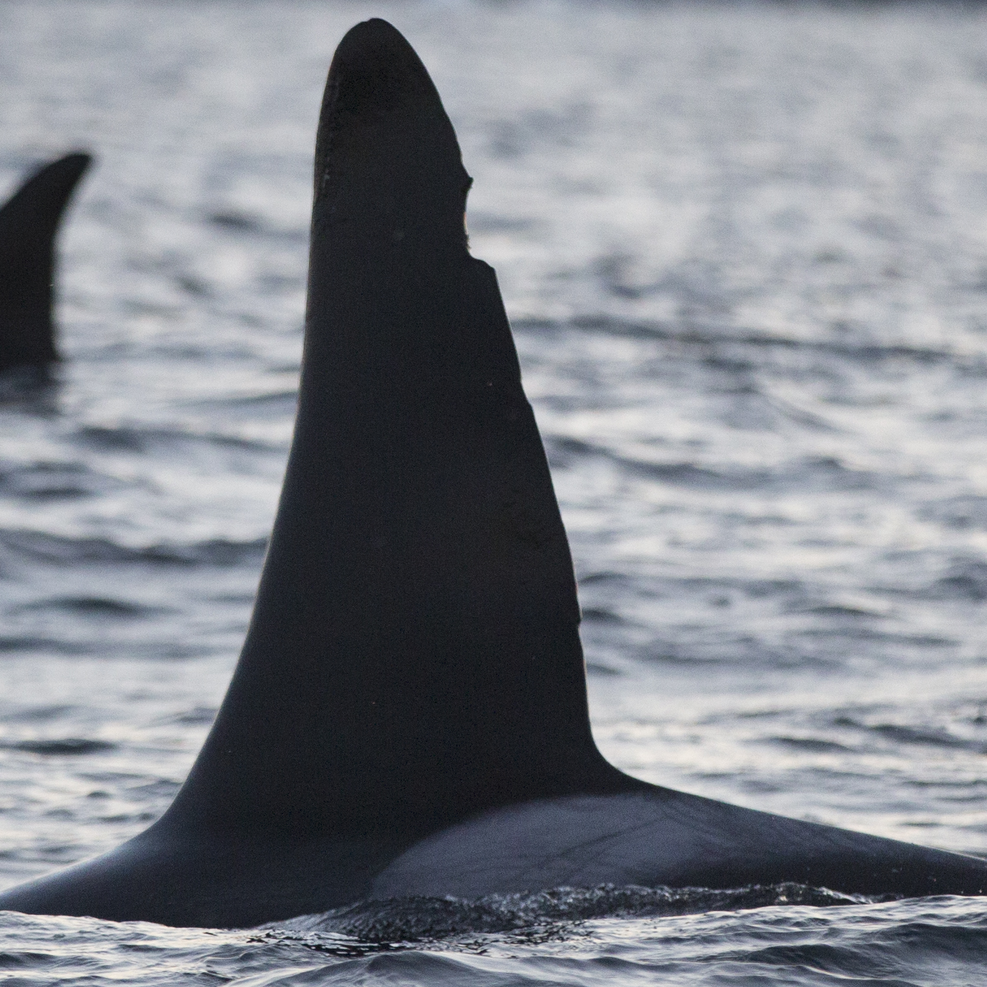
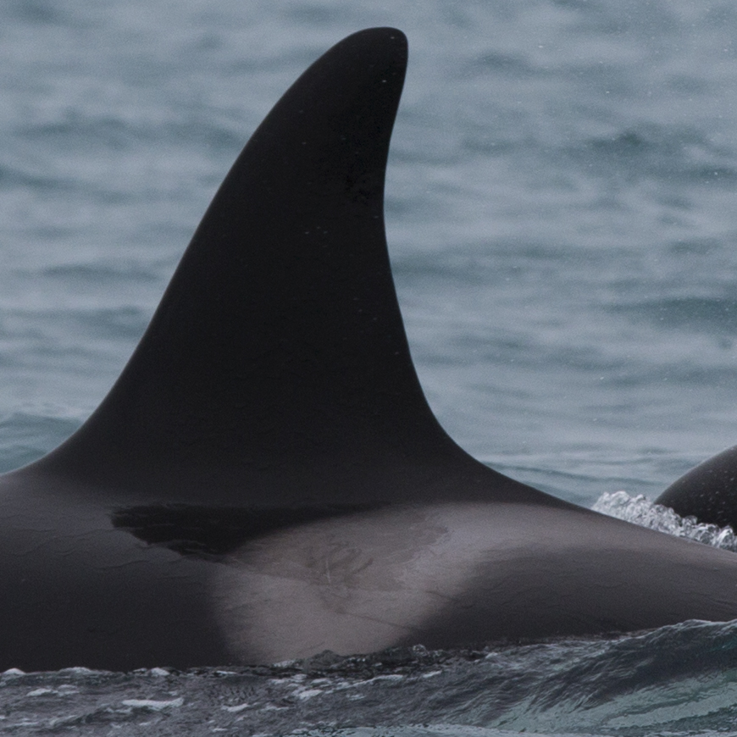
Telling orcas apart

Slide 17
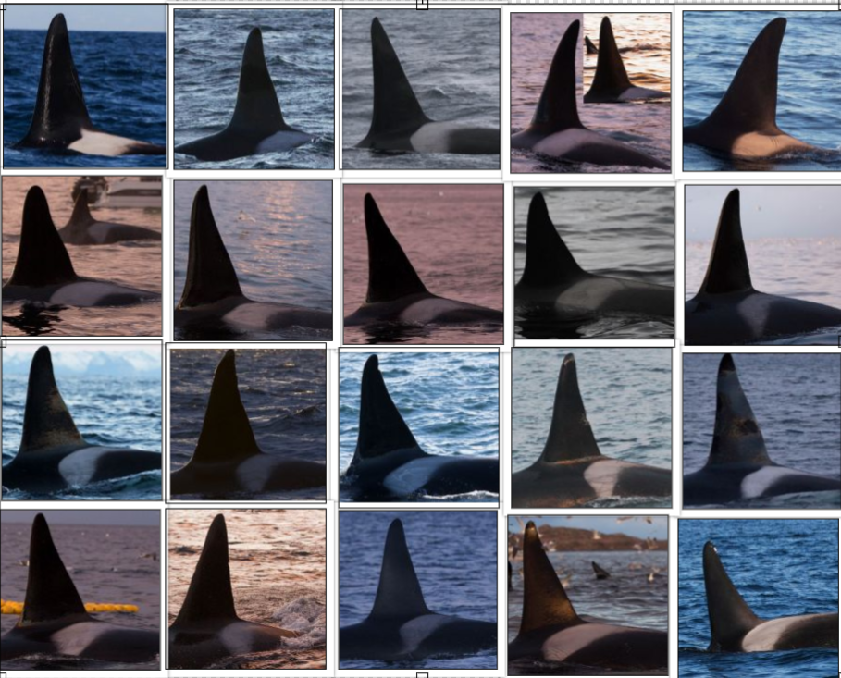
Telling orcas apart?

Slide 18
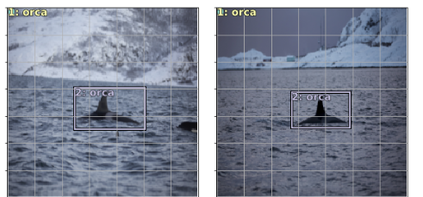
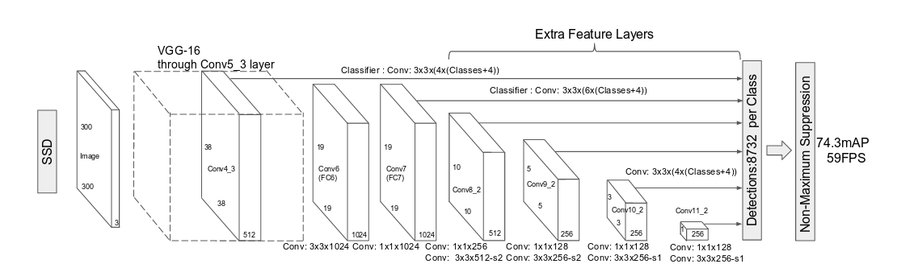
Localization
- Using SSD
- VGG-16 base for transfer learning
- Regressing for position in image and bounding box size

Slide 19
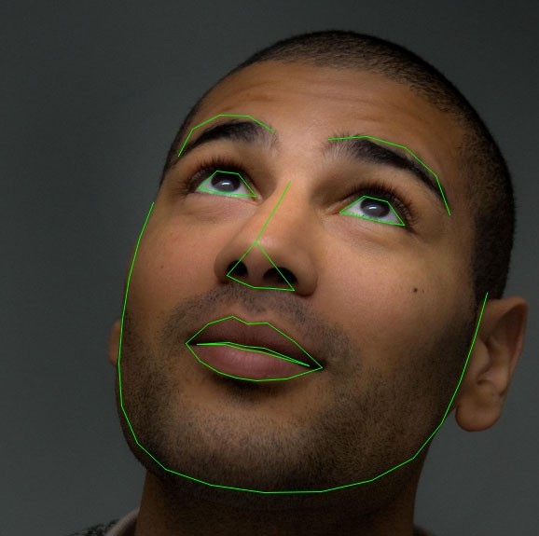
Normalization and Feature Engineering
To make identification of orcas more precise
Find relevant landmarks (Regression Trees, ANNs)
Rotate and center image based on landmarks
Find additional features for identification (f.ex. shape of fin)
Borrow techniques from face detection applications

Slide 20
Orca identification
Not a lot of labeled data
Take advantage of unsupervised learning to semi-automate tagging process
Incrementally and iteratively build a dataset of known individuals
Use standard algorithms such as faceNet

Slide 21
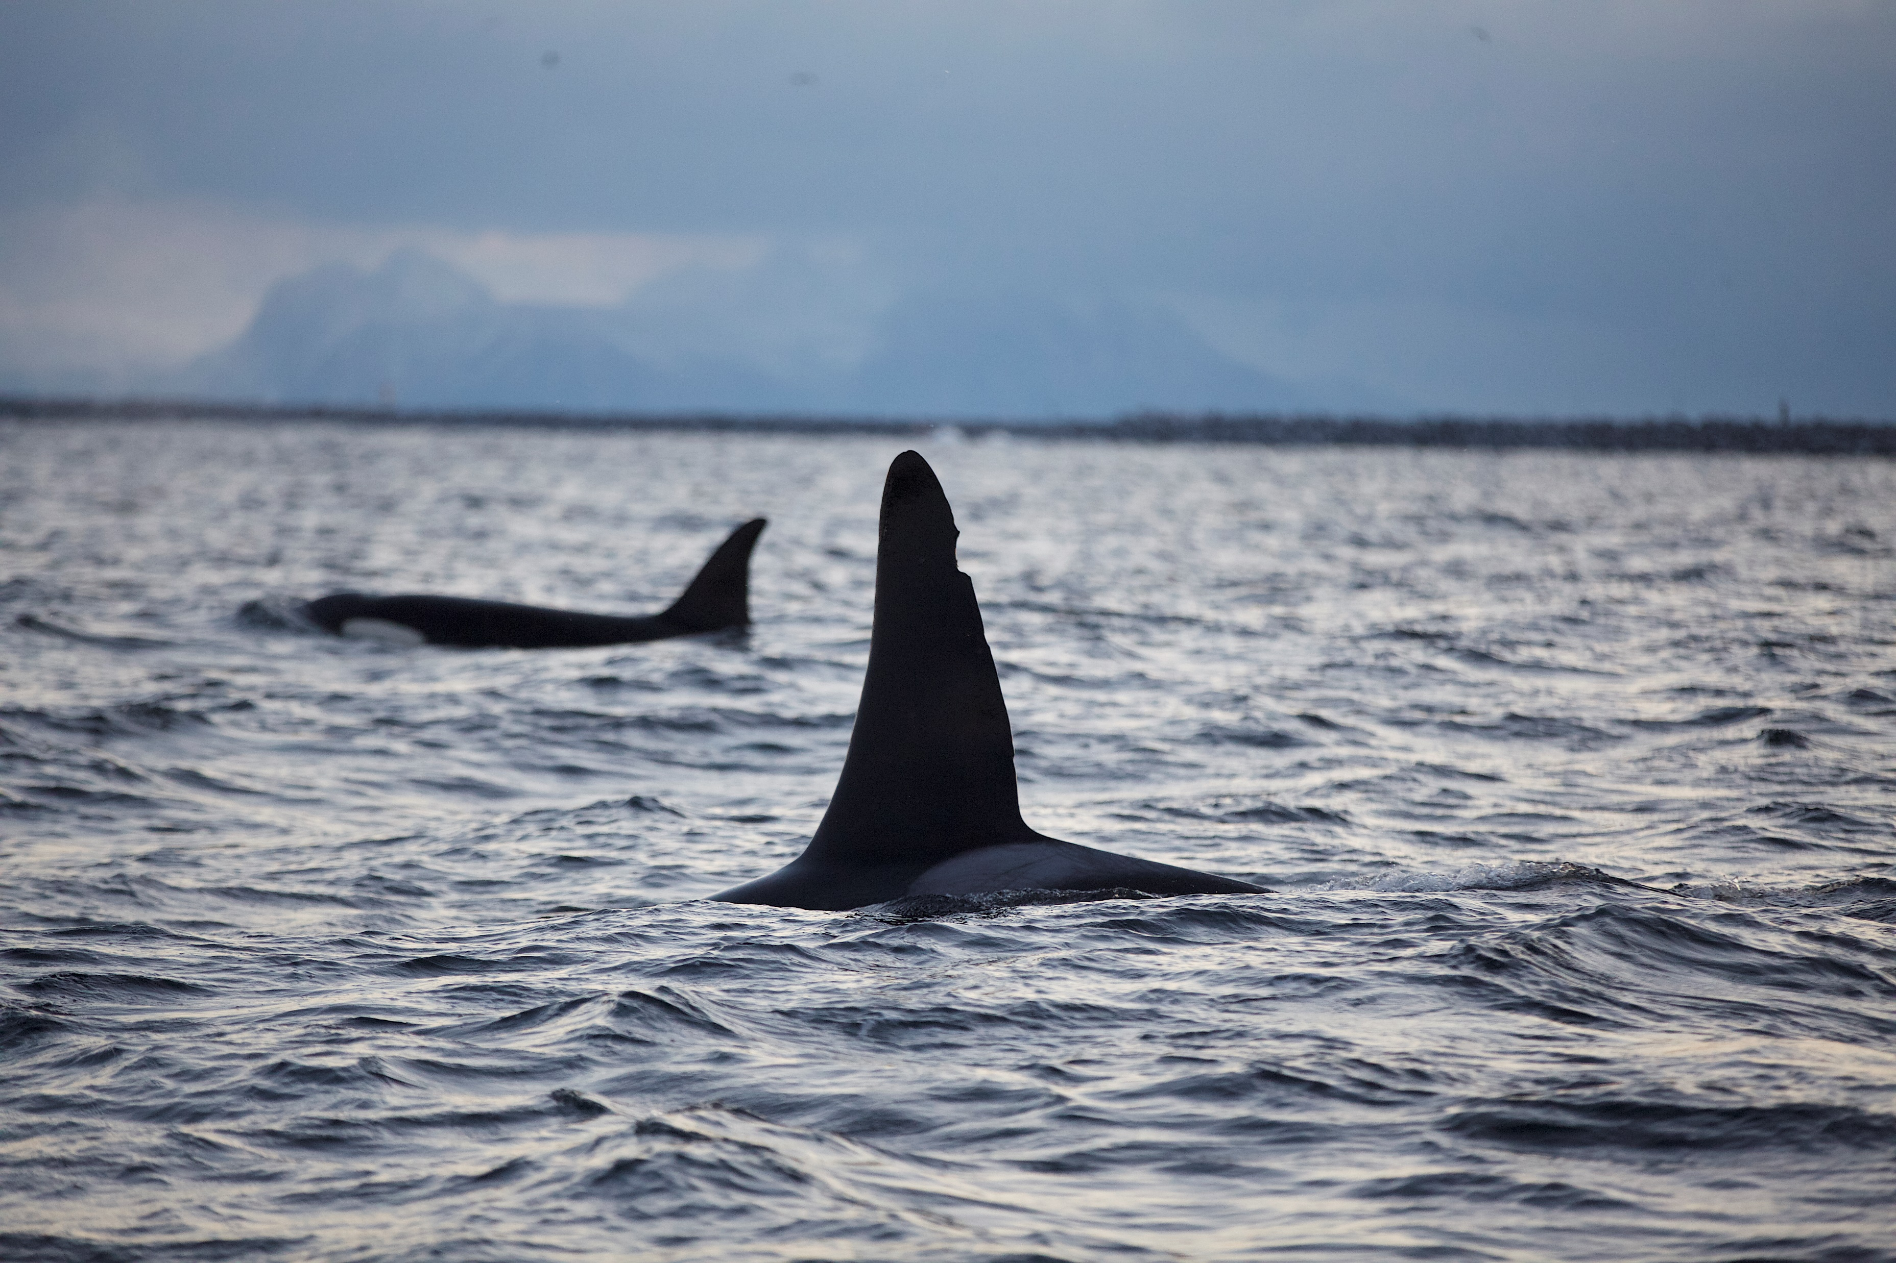
finfindR is an open source project which identify wild dolphins – can it also find Orcas?
finfindR App and R package can be downloaded at https://github.com/haimeh/finFindR

Slide 22
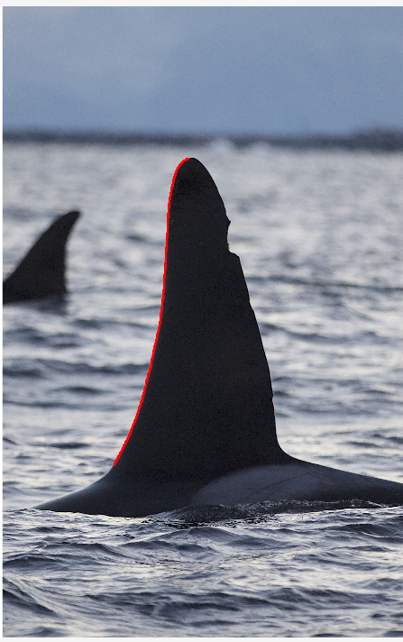
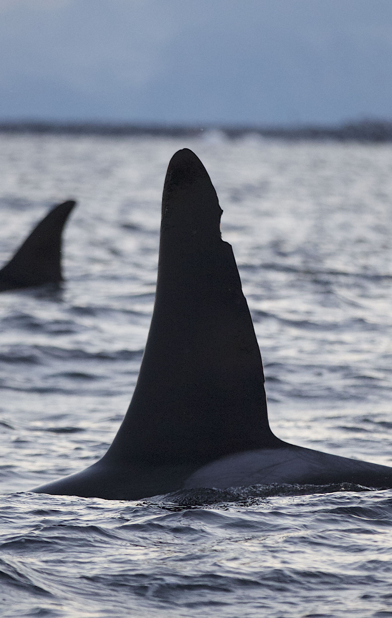
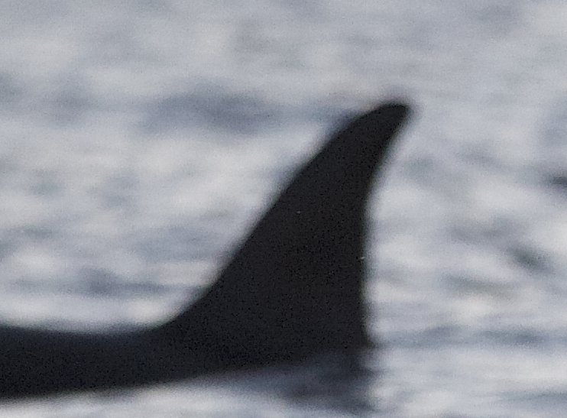
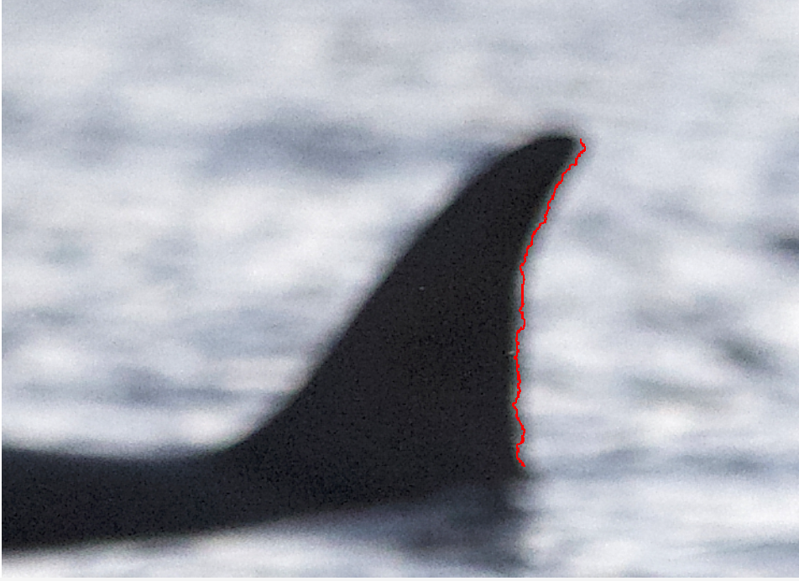
finfindR is an open source project which identify wild dolphins – can it also find Orcas?
- App UI does not fit our needs
+ cropping partly works
- Fin tracing doesn’t find entire fin
Matching based on fin trace untested, does not look at other features
+ possibly models which can be retrained

Slide 23
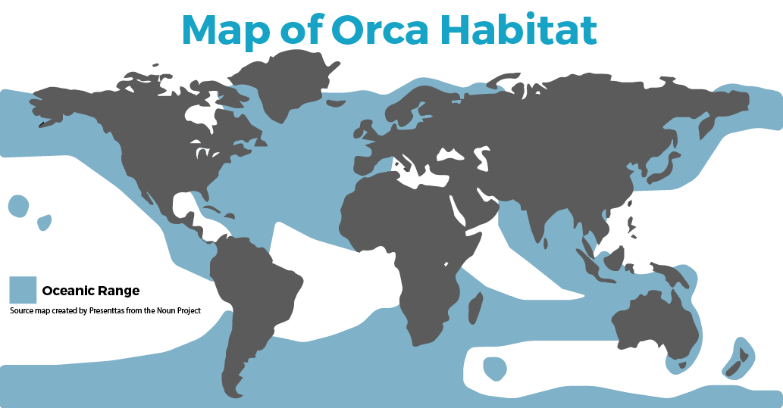

Slide 24
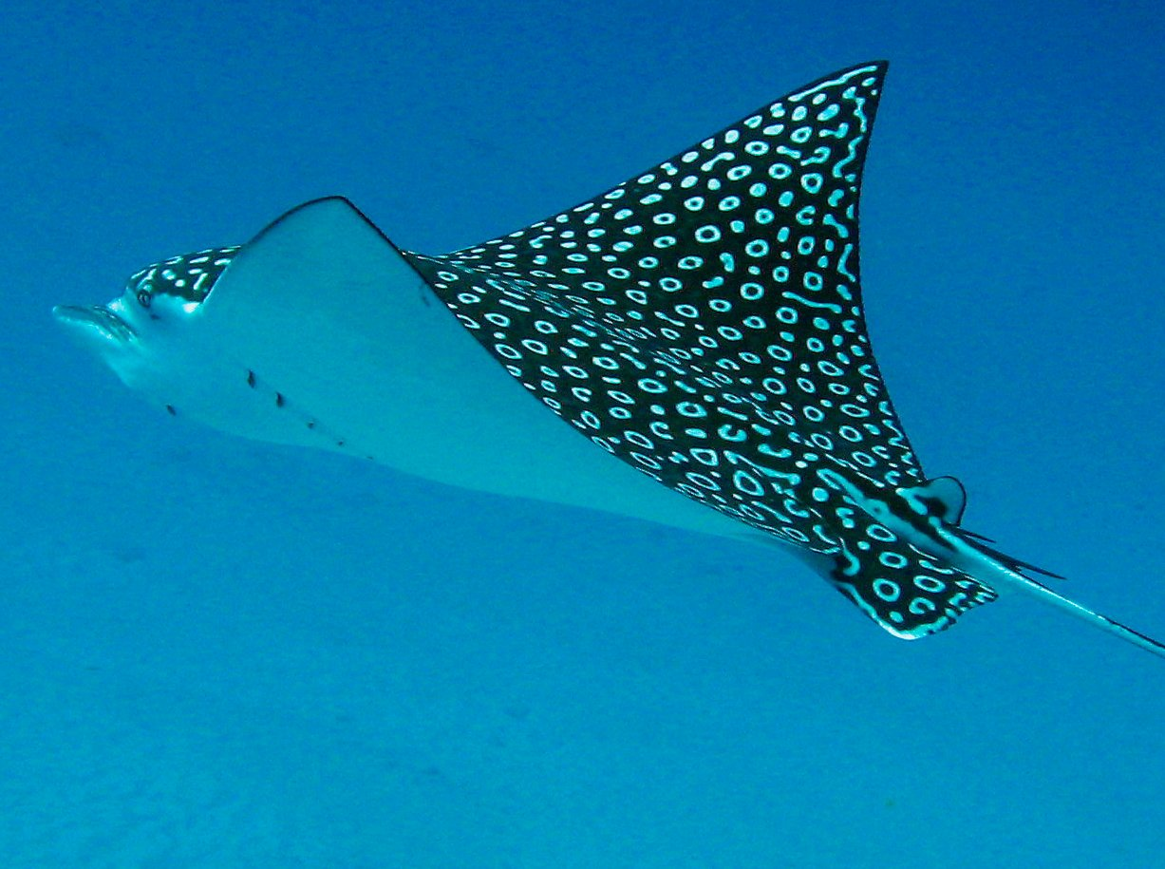
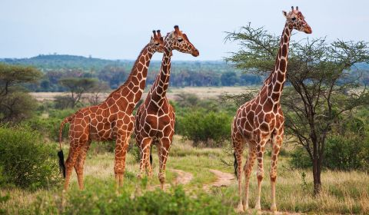
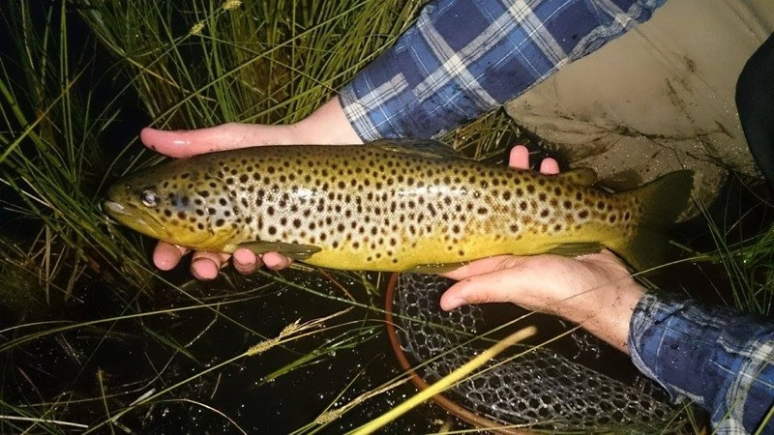
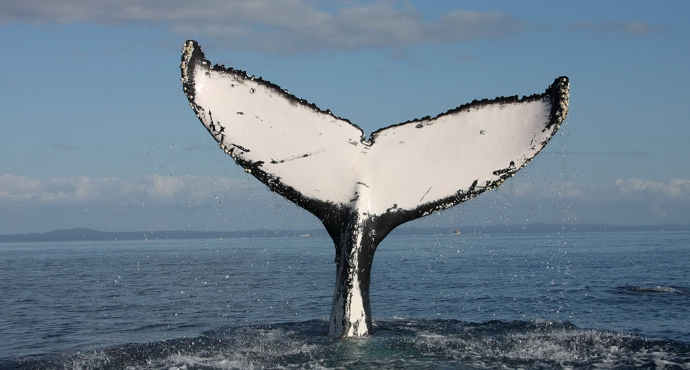
Other animals...

Slide 25
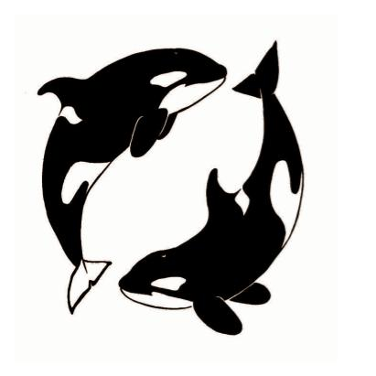
Saving the world one dorsal fin at the time!
Make orcas great again!
The OrcaTag team:
Mikkel Antonsen
Lingzhen Chen
Lene Drøsdal
Bethan Cropp
Scott Adam Smith
Kim Atle Norén
Bjørn Hjelle
https://github.com/bjornhjelle/orcatag

